Slide 1
The Persistence of Active Management
Psychological Utility or Informational Necessity?
Investigating the Behavioral Drivers of the Active Management Puzzle
PhD Research Proposal
Ömer Eren
Bogazici University
Department of Management
09/01/2026

Slide 2
Active Management Puzzle
The persistence of actively managed funds despite all the empirical evidence suggesting persistence alpha generation via active management is virtually impossible.

Slide 3
The Arithmetic of Active Management (Sharpe, 1991)
The return on the average actively managed dollar must equal the return on the average passively managed dollar before costs.
After costs, the average active manager must underperform the passive benchmark.

Slide 4

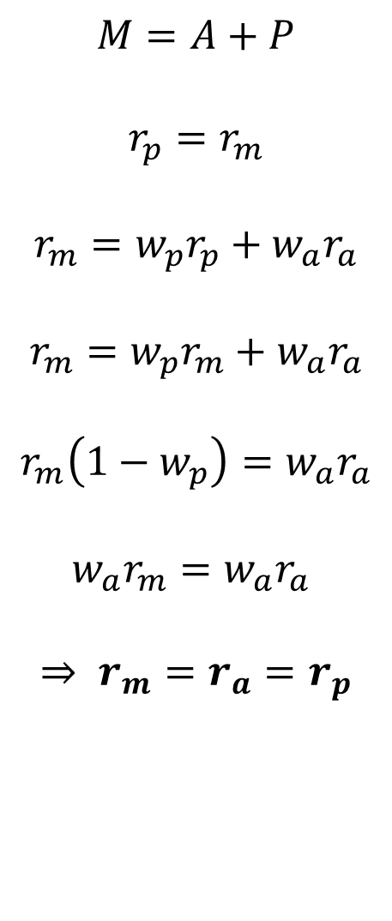
$$M=A+P$$
$$r_{p}=r_{m}$$
$$r_{m}=w_{p}r_{p}+w_{a}r_{a}$$
$$r_{m}=w_{p}r_{m}+w_{a}r_{a}$$
$$r_{m}\left(1−w_{p}\right)=w_{a}r_{a}$$
${w_{a}r}_{m}=w_{a}r_{a}$
$$⇒ r_{m}=r_{a}=r_{p}$$
$$c_{a}>c_{p}$$
$⇒(r_{a}−$ $c_{a})<(r_{p}− c_{p})$

Slide 5
Literature on the Active vs. Passive Debate
Sharpe’s identity does not preclude the possibility that some active managers generate alpha persistently at the expense of others who underperform their benchmark.
Carhart (1997) showed that much of the persistence observed in mutual funds could be attributed to the momentum effect first documented by Jegadeesh and Titman (1993).
Fama and French (2010) conclude that the distribution of net alpha across the industry is almost indistinguishable from random luck.
Although the general consensus on active management find it to be a ‘fool’s errand’ (Dyck, Lins & Pomorski, 2018; Malkiel, 1995), some empirical evidence exists that suggest active management outperferforms passive management on a risk-adjusted basis in emerging markets and small-cap stocks (Gopane, Moyo & Setaka, 2024; Prondzinski & Miller, 2018).

Slide 6
Why do actively managed funds persist?
Informational Necessity
From an Efficient Markets perspective, active management is a ‘necessary evil’.
Active fund managers are ‘arbitrageurs of information’, constantly searching for mispriced securities and trading on them until their prices move back to their fundamental values.
Without active management, there would be no price discovery and markets would collapse (Grossman & Stiglitz, 1980).
However, this line of reasoning cannot account for why investors continue to invest in active funds even though they fail to provide higher risk-adjusted returns compared to indexing.

Slide 7
Why do actively managed funds persist?
Diversification
Investors might be using actively managed funds as a tool for diversification.
Rather than chasing superior risk-adjusted returns, they might be hedging against market crashes and other forms of systematic risk (Basu & Huang-Jones, 2015; Gopane et al., 2024).
Although diversification benefits could certainly play a role in the persistence of active funds, it cannot be the only underlying factor behind such a widely observed phenomenon.
There will always be some investors who don’t care about diversification and some active funds, the portfolios of which don’t correlate negatively with the market.

Slide 8
Why do actively managed funds persist?
The behavioral explanation
Seminal works by Tversky and Kahneman (1974, 1992) and De Bondt and Thaler (1985) firmly established the fact that financial agents don’t act in a perfectly rational fashion.
They often fail victim to cognitive biases that are deeply rooted in human psychology.
Persistence of active management could be the result of behavioral biases like Overconfidence, Better-Than-Average Effect, Illusion of Control and Skewness Preference to name a few.
The claim that the Active Management Puzzle cannot be fully explained without allowing for behavioral biases is supported by the literature (Foster & Warren, 2015, 2016).

Slide 9
Hypothesis development
We argue that investors purchase active funds not solely for wealth maximization, but also for other non-pecuniary benefits, similar to «expressive benefits» of Statman (2004).
The need to access these benefits stem from cognitive biases, of which we focus on three:
Overconfidence: The belief in one’s ability to select future winners (Barber & Odean, 2001).
Illusion of control: The tendency to overestimate influence over chance events (Langer, 1975).
Skewness preference: The «lottery effect», where investors overweight low probabilities of extreme returns (Tversky & Kahneman, 1992).

Slide 10
Hypothesis development
Based on these three biases, we form three distinct testable hypotheses:
H1: The sensitivity of fund flows to past performance is not static. During periods of high investor sentiment, return chasing becomes more prevalent.
H2: Increases in aggregate Margin Debt (our proxy for control illusion) will correlate with reduced outflows from underperforming funds.
H3: During periods of high sentiment, capital inflows will be positively correlated with Active Share. In other words, ‘more’ active funds will receive more inflow compared to closet indexers.

Slide 11
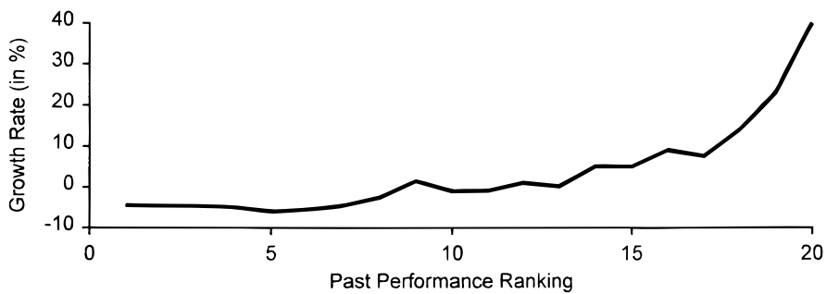
Figure 1: Fund flow convexity (Sirri & Tufano, 1998)

Slide 12
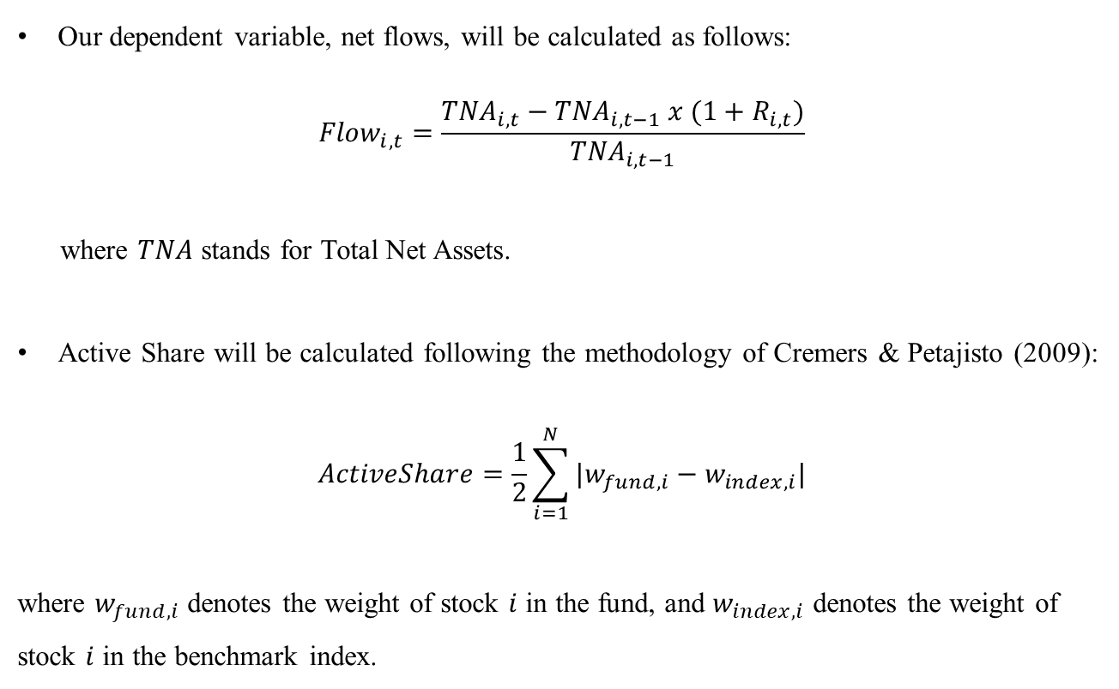
Data & Variable Construction
Our dependent variable, net flows, will be calculated as follows:
$${Flow}_{i,t}=\frac{{TNA}_{i,t}−{TNA}_{i,t−1} x (1+R_{i,t})}{{TNA}_{i,t−1}}$$
where $TNA$ stands for Total Net Assets.
Active Share will be calculated following the methodology of Cremers & Petajisto (2009):
$$ActiveShare=\frac{1}{2}\sum_{i=1}^{N}{|w_{fund,i}−w_{index,i}|}$$
where $w_{fund,i}$ denotes the weight of stock $i$ in the fund, and $w_{index,i}$ denotes the weight of stock $i$ in the benchmark index.

Slide 13
Data & Variable Construction
We’ll use three behavioral independent variables, all of which are listed below:
Sentiment: The orthogonalized Baker-Wungler Sentiment Index, which captures investor propensity to speculate.
Margin Debt: Year-over-change in FINRA margin debt balances, serving as a proxy for the Illusion of Control.
Turnover Ratio: Market-wide share turnover, serving as a proxy for investor conviction/overconfidence.

Slide 14
Controls for Fund Characteristics
Fund Size: Measured through TNA.
Fund Age: Time passed since the inception of the fund.
Expense Ratio: The annual management fee.
Volatility: The rolling 12-month standard deviation of returns.
Investment Style: We plan to include dummy variables for Growth vs. Value and Small vs. Large Cap.

Slide 15
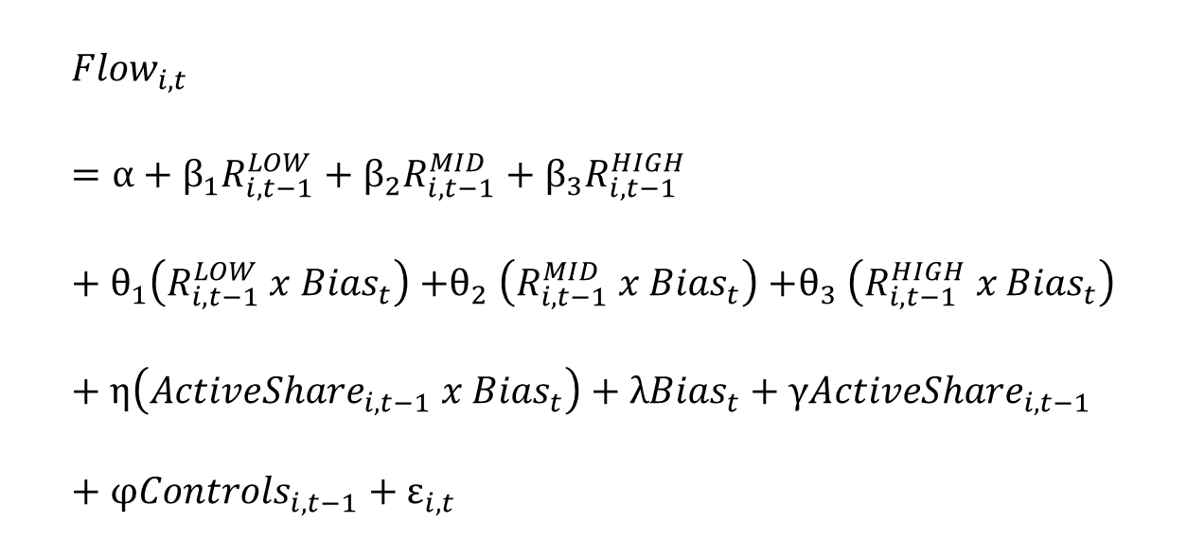
Empirical Model
$${Flow}_{i,t}=α+β_{1}R_{i,t−1}^{LOW}+β_{2}R_{i,t−1}^{MID}+β_{3}R_{i,t−1}^{HIGH} +θ_{1}\left(R_{i,t−1}^{LOW} x {Bias}_{t}\right){+θ}_{2}\left(R_{i,t−1}^{MID} x {Bias}_{t}\right){+θ}_{3}\left(R_{i,t−1}^{HIGH} x {Bias}_{t}\right)+η\left({ActiveShare}_{i,t−1} x {Bias}_{t}\right)+λ{Bias}_{t}+γ{ActiveShare}_{i,t−1}+φ{Controls}_{i,t−1}+ε_{i,t}$$

Slide 16
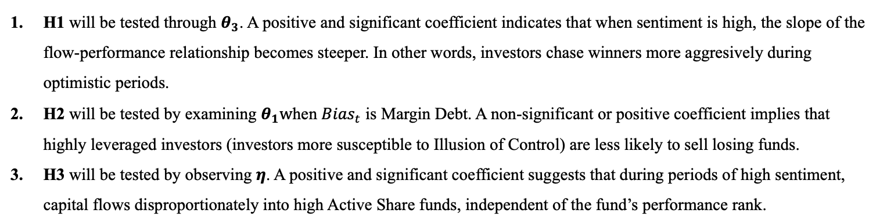
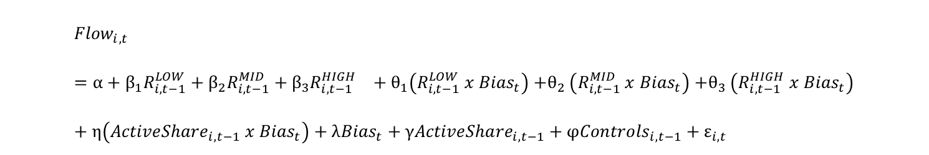
Hypothesis Testing
$${Flow}_{i,t}=α+β_{1}R_{i,t−1}^{LOW}+β_{2}R_{i,t−1}^{MID}+β_{3}R_{i,t−1}^{HIGH} +θ_{1}\left(R_{i,t−1}^{LOW} x {Bias}_{t}\right){+θ}_{2}\left(R_{i,t−1}^{MID} x {Bias}_{t}\right){+θ}_{3}\left(R_{i,t−1}^{HIGH} x {Bias}_{t}\right)+η\left({ActiveShare}_{i,t−1} x {Bias}_{t}\right)+λ{Bias}_{t}+γ{ActiveShare}_{i,t−1}+φ{Controls}_{i,t−1}+ε_{i,t}$$
H1 will be tested through $θ_{3}$. A positive and significant coefficient indicates that when sentiment is high, the slope of the flow-performance relationship becomes steeper. In other words, investors chase winners more aggresively during optimistic periods.
H2 will be tested by examining $θ_{1}w$hen ${Bias}_{t}$ is Margin Debt. A non-significant or positive coefficient implies that highly leveraged investors (investors more susceptible to Illusion of Control) are less likely to sell losing funds.
H3 will be tested by observing $η$. A positive and significant coefficient suggests that during periods of high sentiment, capital flows disproportionately into high Active Share funds, independent of the fund’s performance rank.

Slide 17
Psychological Premium
We propose to estimate the Psychological Premium, defined as the marginal expected return an investor is willing to sacrifice to acquire a unit of Lottery-ness (Active Share).
This will be done by calculating the Marginal Rate of Substitution between these two variables, implied by our regression coefficients.
By taking the total derivative of Fund Flow and equalizing it to 0, we are able to derive a term for a time-varying Psychological Premium.

Slide 18
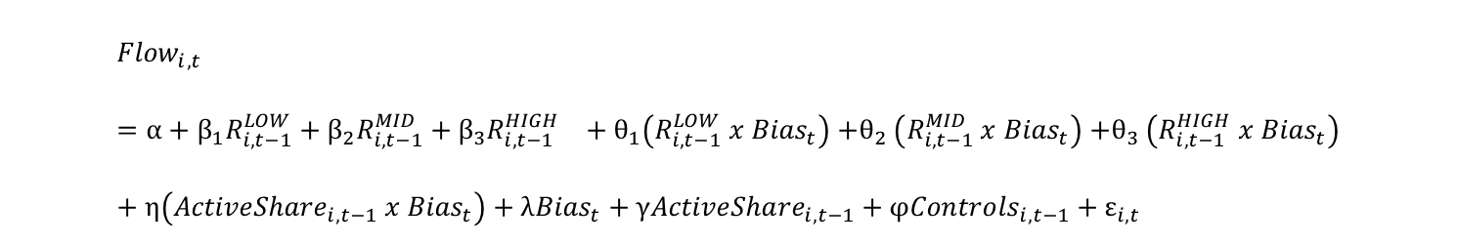
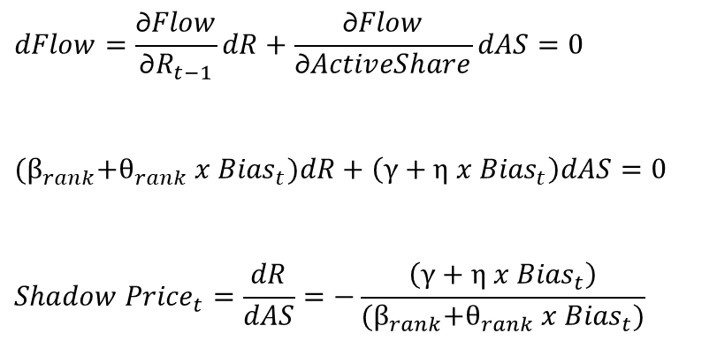
Psychological Premium
$${Flow}_{i,t}=α+β_{1}R_{i,t−1}^{LOW}+β_{2}R_{i,t−1}^{MID}+β_{3}R_{i,t−1}^{HIGH} +θ_{1}\left(R_{i,t−1}^{LOW} x {Bias}_{t}\right){+θ}_{2}\left(R_{i,t−1}^{MID} x {Bias}_{t}\right){+θ}_{3}\left(R_{i,t−1}^{HIGH} x {Bias}_{t}\right)+η\left({ActiveShare}_{i,t−1} x {Bias}_{t}\right)+λ{Bias}_{t}+γ{ActiveShare}_{i,t−1}+φ{Controls}_{i,t−1}+ε_{i,t}$$
MRS calculation
$$dFlow=\frac{\text{∂}Flow}{\text{∂}R_{t−1}}dR+\frac{\text{∂}Flow}{\text{∂}ActiveShare}dAS=0$$
$${(β}_{rank}+θ_{rank} x {Bias}_{t})dR+\left(γ+η x {Bias}_{t}\right)dAS=0$$
$${Shadow Price}_{t}=\frac{dR}{dAS}=−\frac{\left(γ+η x {Bias}_{t}\right)}{{(β}_{rank}+θ_{rank} x {Bias}_{t})}$$

Slide 19
Expected Contributions
While standard finance theory models active funds as «investment goods», our findings may suggest they function more like «consumption goods», purchased for psychological utility.
If capital flows are driven by sentiment and skewness preference rather than skill assessment, current regulatory frameworks might be insufficient.
Our results predict a continued bifurcation of the market structure. If active funds are purchased for psychological utility rather than risk-adjusted return maximization, closet-indexers (funds with low active share) have no real benefits as they provide no additional returns compared to indexing while offering little psychological utility.

